Slide 1
Funding for Behavioral Health Services in Florida
Commission on Mental Health and Substance Abuse
Finance Subcommittee
May 18, 2022
Tom Wallace, Florida Medicaid Director

Slide 2
Medicaid Funding for Behavioral Health Services
Federal Share
Recurring
Regular FMAP (additional 6.2% until September 30)
State Share
Recurring
General Revenue
FACT – other state funds (DCF)

Slide 3
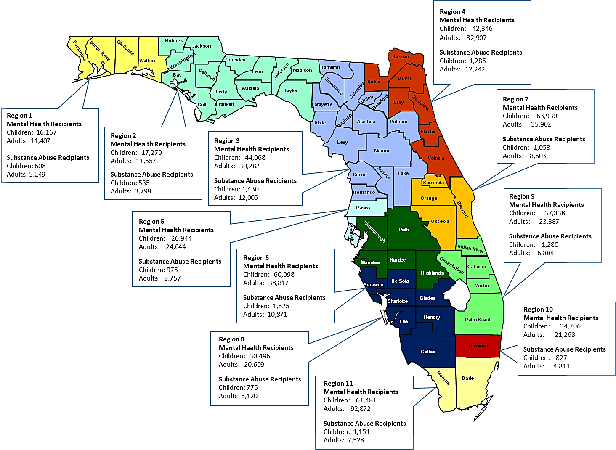
Mental Health and Substance Abuse Service Recipients by Region
FY2020-21

Slide 4
The graph shows an increase across children and adult mental health and substance abuse services from FY 17/18 to FY 20/21.

Slide 5
Definitions
Behavioral Health Categories
Mental Health = Claims with primary diagnosis code starting with F0 or F2 - F9, and MH pharmacy claim records
 | MH Treatment Services | Claims with a procedure code/modifiers or other field values indicating a specific mental health treatment, excluding Behavior Analysis. These services include Community Behavioral Health Services, Medicaid Certified School Match, TCM for Mental Health, Specialized Therapeutic Services, FQHC Services, SIPP, and Behavioral Health Overlay Services.
 | MH Inpatient Hospital | Inpatient hospital claims with a primary diagnosis code starting with F0 or F2-F9.
 | MH Outpatient Hospital | Outpatient hospital claims with a primary diagnosis code starting with F0 or F2-F9.
 | Long Term Care Services with a BH Primary Dx | Long Term Care claims with a primary diagnosis code starting with F0 or F2-F9.
 | Other Services with a BH Primary Dx | All other claim records with a primary diagnosis of F0 or F2-F9, excluding Behavior Analysis.
 | Pharmacy | Pharmacy claim records with an NDC for a MH treatment-related drug.
 | Behavior Analysis | Claims with a procedure code/modifiers specific to Behavior Analysis. These services include Behavior Assessment, Behavior Reassessment, Behavior Analysis (Lead Analyst, Assistant Behavior Analyst, Technician and Group)
Substance Use Disorder = Claims with primary diagnosis code starting with F1, and SUD pharmacy claim records
 | SUD Treatment Services | Claims with a procedure code/modifiers or other field values indicating a specific SUD treatment. The services can be similar to those under MH Treatment Services, but with a different set of procedure code modifiers indicating an SUD treatment service.
 | SUD Inpatient Hospital | Inpatient hospital claims with a primary diagnosis code starting with F1.
 | SUD Outpatient Hospital | Outpatient hospital claims with a primary diagnosis code starting with F1.
 | Other Services with an SUD Primary Dx | All other claim records with a primary diagnosis of F1.
 | SUD MAT Pharmacy | Pharmacy claim records with an NDC for a SUD MAT-related drug
Child/Adult classification for claim data is based on the recipient's age at the time of the earliest claim record in the fiscal year
Child: age < 21; Adult: age >= 21
Total Medicaid Population is based on the number of recipients eligible at any time within the fiscal year
For the Total Medicaid Population counts, Child/Adult classification is based on each recipient's final entry in the ELIG table for the fiscal year

Slide 6
FY 2020-2021 Mental Health Expenditures - Child
Children's MH Expenditures by Service Type
Service | Distinct Claims | Total Expenditures
Behavior Analysis | 3,304,320 | $1,684,675,094
Long Term Care Services with a BH Primary Dx | 2,104 | $26,644,647
MH Inpatient Hospital | 93,734 | $341,523,179
MH Outpatient Hospital | 439,122 | $94,197,820
MH Treatment Services | 6,700,180 | $530,503,265
Other Services with a BH Primary Dx | 7,853,014 | $792,449,431
Pharmacy | 2,941,890 | $370,148,598
Grand Total | 39,310,148 | $5,995,608,973

Slide 7
FY 2020-2021 Mental Health Expenditures - Adult
Adult's MH Expenditures by Service Type
Service | Distinct Claims | Total Expenditures
Long Term Care Services with a BH Primary Dx | 157,463 | $1,035,523,077
MH Inpatient Hospital | 96,842 | $300,502,508
MH Outpatient Hospital | 134,219 | $23,505,725
MH Treatment Services | 8,348,362 | $1,800,698,026
Other Services with a BH Primary Dx | 2,788,704 | $558,775,659
Pharmacy | 4,559,294 | $423,860,635
Grand Total | 16,084,884 | $4,142,865,629

Slide 8
FY 2020- 2021 Substance Abuse Expenditures - Child
Children's SA Expenditures by Service Type
Service | Distinct Claims | Total Expenditures
Other Services with an SUD Primary Dx | 68,792 | $5,304,225
SUD Inpatient Hospital | 2,560 | $10,598,913
SUD MAT Pharmacy | 3,210 | $211,382
SUD Outpatient Hospital | 5,916 | $3,298,578
SUD Treatment Services | 10,998 | $654,314
Grand Total | 91,476 | $20,067,412

Slide 9
FY 2020- 2021 Substance Abuse Expenditures - Adult
Adult's SA Expenditures by Service Type
Service | Distinct Claims | Total Expenditures
Other Services with an SUD Primary Dx | 761,580 | $42,650,272
SUD Inpatient Hospital | 23,828 | $68,480,528
SUD MAT Pharmacy | 108,712 | $24,199,616
SUD Outpatient Hospital | 41,776 | $12,767,960
SUD Treatment Services | 803,416 | $53,719,117
Grand Total | 1,739,312 | $201,817,492

