Slide 1
Child Health and Federal Medicaid/CHIP Activities
Joan Alker
Executive Director/Research Professor
Center for Children and Families
McCourt School of Public Policy
Georgetown University
September 8, 2022

Slide 2
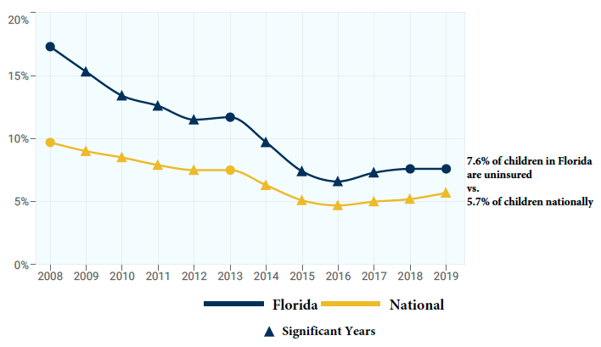
Child Uninsured Rate in Florida and the US

Slide 3
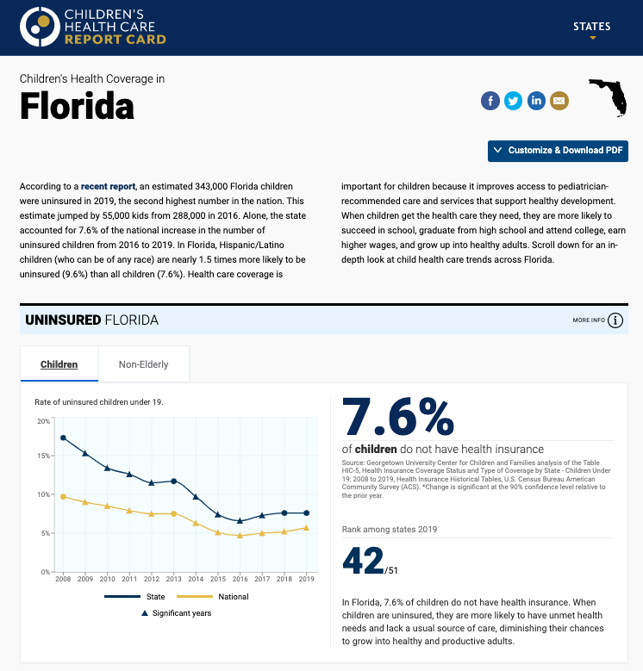
The Children’s Health Care Report Card
View our interactive data hub for a closer look at how children’s public coverage is in your state.
https://kidshealthcarereport.ccf.georgetown.edu/

Slide 4
Current Framework for Medicaid Continuous Coverage Protection
Enhanced Federal Funding
Maintenance of Effort (MOE)
Twin economic and public health crises
Congress provided an extra 6.2 percentage points in the federal Medicaid match rate; 4.34% in additional CHIP match (earliest end = Q1 2023)
Through the end of the quarter the PHE ends
States must meet certain maintenance of effort provisions (MOE)
Maintain eligibility levels and enrollment procedures
Cannot add or increase premiums
Keep Medicaid enrollees continuously covered through end of the month the PHE ends (earliest January 2023)
Does not apply to separate CHIP programs

Slide 5
Percent Enrollment Changes in Child Medicaid/CHIP in Florida and the US December 2017 – April 2022

Slide 6
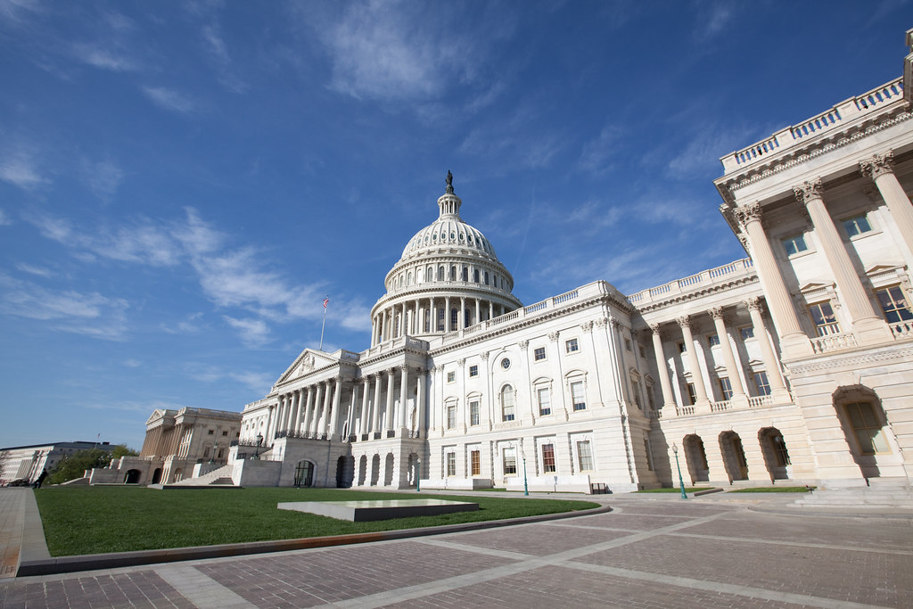
How Long is the PHE in Place and How Will it End??
Secretary Becerra extended the PHE to October 13, 2022 and will extend it again for 90 days.
The Biden Administration will give states 60 days advance notice if they plan to lift it
Congress could act to lift the Medicaid continuous coverage protection on a date certain as the House did in Build Back Better.
States could reject the extra federal funding individually

Slide 8
Federal Regulatory Activity
Medicaid/CHIP eligibility and enrollment NPRM. Comments are due c. November 7th.
Eliminates waiting periods, lockouts, and lifetime/annual benefit limits in CHIP
Aims to smooth transitions from Medicaid/CHIP and vice versa
Mandatory Medicaid/CHIP Quality Core Set Reporting
States must start reporting all child measure in FFY2024
Comments on reg due 10/21
CMS is working on a major rule on improving access in Medicaid in the managed care context;
Section 1115 waiver activity is ongoing with litigation playing a significant role in red states

Slide 9
Federal Action on Mental Health: Medicaid and CHIP
Anne Dwyer
Associate Research Professor
Center for Children and Families
McCourt School of Public Policy
Georgetown University
September 8, 2022

Slide 10
Children’s Mental Health Status
31% of children enrolled in Medicaid or CHIP as of 2020 had a mental, emotional, developmental, or behavioral problem
Of those who received care – 35% had a somewhat or very difficult time obtaining mental health care

Slide 11
Children’s Mental Health & Pandemic Stressors
HRSA Researchers
Anxiety and depression among children ages 3-17 increased from 2016 to 2020
As of 2020, 5.6 million kids (9.2%) were diagnosed with anxiety and 2.4 million (4.0%) were diagnosed with depression
CMS
Stressors related to the COVID pandemic have resulted in “surge of behavioral health concerns in children and youth"
CDC
From March 2020 until October 2020, mental health-related ED visits increased 24 percent for children ages 5 to 11, and 31 percent for those ages 12 to 17 compared with pre-pandemic levels

Slide 12
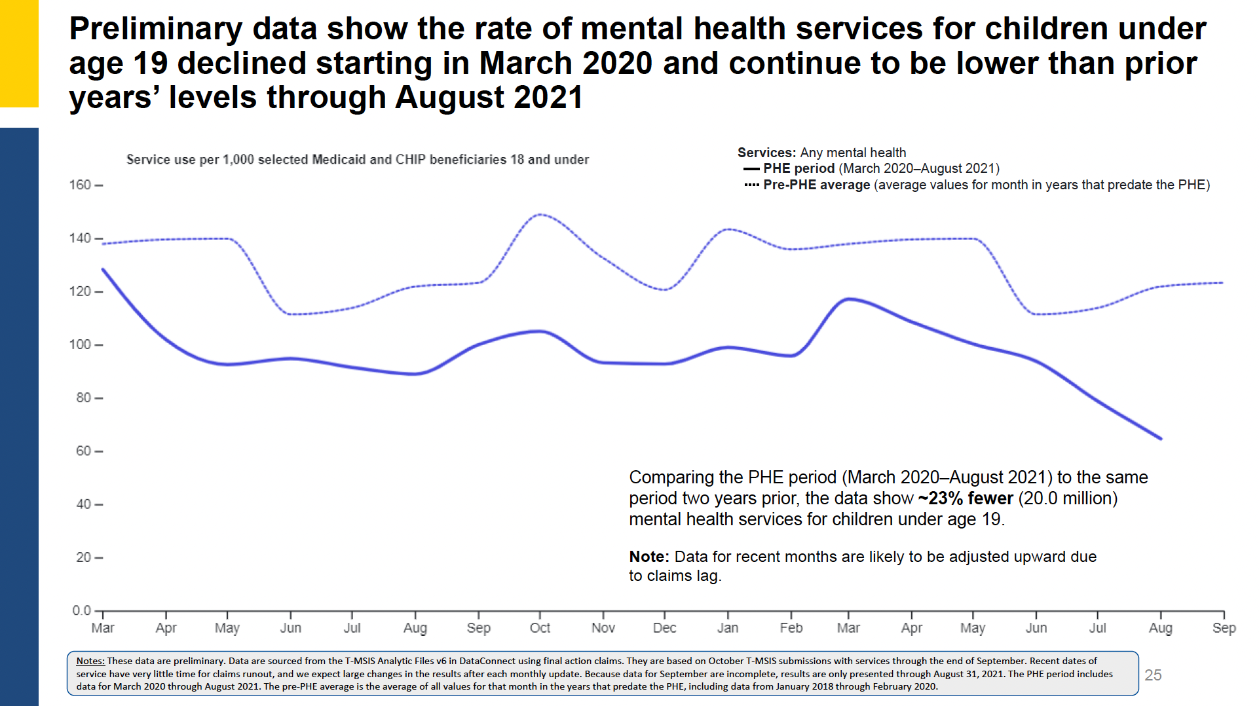
Decline in Rate of Mental Health Services
Approx. 23% fewer – 27.3 million – mental health services for children under age 19 when compare pandemic period to pre-pandemic period

Slide 13
Federal Action

Slide 14
Congressional Action
Bipartisan Safer Communities Act
Signed into law on June 25th, Pub. Law 117-158
Restoring Hope for Mental Health and Well-Being Act of 2022 (H.R 7666)
passed by House June 22^{nd.}
Senate yet to take up
Senate Finance Committee discussion drafts
Telehealth discussion draft – released in May
Children and youth discussion draft – released in June
No official committee or floor action scheduled as of yet

Slide 15
Bipartisan Safer Communities Act
CCBHC
Expands Medicaid CCBHC demo nationally
Telehealth
Guidance and technical assistance
Medicaid & Schools
Guidance
Technical assistance center
$50 million in grants to states to support school-based services under Medicaid and CHIP
EPSDT oversight
Mandated HHS reviews of state EPSDT implementation, technical assistance, guidance, report to Congress and GAO report

Slide 16
Bipartisan Safer Communities Act
Additional school-based funding
$500 million through the School Based Professionals Grant Program
$500 million in funding to the School Based Mental Health Service Professionals Demonstration Grant
Pediatric-focused programs
$60 million for primary care training and enhancement
Reauthorizes and provides $80 million in support for the Pediatric Mental Health Care Access Program

Slide 17
HR 7666 – Restoring Hope
Senate Finance Committee
School-based guidance; Telehealth guidance; EPSDT oversight language
Required health screens and referrals for juveniles in public institutions
State option to provide Medicaid & CHIP to juveniles in public institutions pre-sentencing
Guidance to states on supporting mental health services for youth
Guidance to states on flexibilities to ensure provider capacity
School-based guidance; Telehealth guidance; EPSDT oversight language
Required health screens and referrals for juveniles in public institutions
State option to provide Medicaid & CHIP to juveniles in public institutions pre-sentencing
Guidance to states on supporting mental health services for youth
Analysis and publication of Medicaid data related to mental health and SUD
Requiring Medicaid coverage for services provided on the same day (i.e., same-day billing)
Streamlined enrollment for out-of-state providers in Medicaid and CHIP providing services for children
Including telehealth in provider directories
Disregard certain CHIP HSI expenditures for behavioral health services for children in schools

Slide 18
Administration Action
CMS Informational Bulletins
Behavioral Health Services & Children
Leveraging Medicaid, CHIP, and Other Federal Programs in the Delivery of Behavioral Health Services for Children and Youth (August 18, 2022)
Medicaid & Schools
Information on School-Based Services in Medicaid: Funding, Documentation and Expanding Services (August 18, 2022)
More to come
Medicaid schools claiming guide, TA center, and $50 million in grants
Telehealth guidance
EPSDT guidance and state reviews

Slide 19
Want to learn more?
Visit our website:
https://ccf.georgetown.edu
Check out our state data hub:
https://kidshealthcarereport.ccf.georgetown.edu/
Follow ups on twitter:
@GeorgetownCCF

