Slide 1
CHA Federal Update
Florida Association of Children’s Hospitals
Sept. 8, 2022
Orlando, FL
Notes:
Aimee

Slide 2
Agenda
Policy priorities and status
Next steps to advance
Discussion/questions
Notes:
Aimee

Slide 3
Policy Priorities
Address current children’s mental health challenges and work on longer term solutions improving health at a broader community level.
Increase CHGME funding to address the gap in funding between physician training for adults compared to children and address broader workforce challenges.
Bolster Medicaid for kids to maintain and strengthen its critical role for children and children’s hospitals.
Support pediatric capacity, including children’s hospitals, to ensure a strong health care system for children.
Notes:
Aimee

Slide 4
Sound the Alarm for Kids
Raise awareness of the emergency in child and adolescent mental health.
Amplify our expert partners’ voices.
Provide opportunities for collective engagement.
Elevate the unique needs of kids in mental health policy discussions.
A communications initiative presented by CHA, AAP and American Academy of Child and Adolescent Psychiatry.
Notes:
Elizabeth - Last year, CHA, AAP and the American Academy of Child and Adolescent Psychiatry launched the Sound the Alarm for kids Initiative. Since then, The initiative continues to be multifaceted and focuses on urging Congress to enact legislation and increase funding to address the youth mental health crisis. Currently Sound the Alarm has over 60 mental health organizations which we call our partners and 76 children’s hospitals.

Slide 5
Sound the Alarm Town Halls
Sound the Alarm for Kids has partnered with congressional caucuses on a series of roundtable town hall-style discussions focused on the mental health of children and adolescents across diverse communities.
3/22 4/28 6/23
Family Perspectives (4/31) & Media Roundtable (6/28)
One Year Anniversary of Sound the Alarm for Kids (week of action)
Notes:
Elizabeth
Sound the Alarm for Kids has partnered with congressional caucuses on a series of roundtable town hall style discussions focused on the mental health of children and adolescents across diverse communities. So far we have conducted roundtables With the Congressional Black Caucus, Hispanic caucus, and the LGBTQ+ Equality caucus. In addition, we've done events focused on families and another with key mental health reporters for our media roundtable.
Oct 19 will mark the one year anniversary and we plan to do a week of action which will include amplifying the voices of our partners and the founding organizations. We will also have a media engagement. We will share more details as they become available.

Slide 6
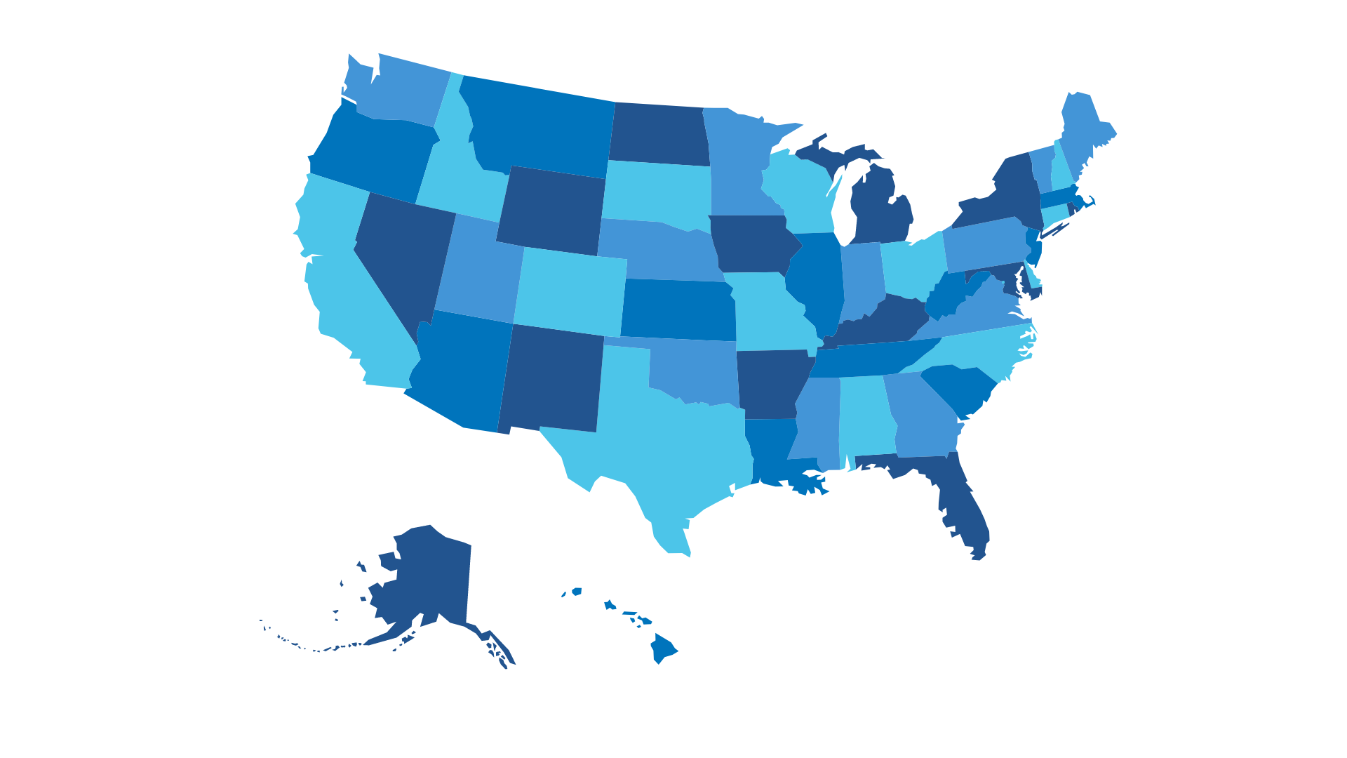
Children’s Mental Health – A National Emergency July Mental Health D.C. Fly-In
24
21
States
Behavioral
Health
Experts
80
45​
Children's
Hospital
Staff
Government
Relations
Staff
2
8
COOs
CEOs
Notes:
Elizabeth

Slide 7
Behavioral Health Policy Priorities
Medicaid Rates
Workforce Development
Continuum of Care
Infrastructure
Investment
Telehealth
Increase critical Medicaid investments in pediatric behavioral health services, such as Medicaid parity with Medicare payment rates for similar services – Included in H.R. 7236 and version included in S.4747
Expand investments to support the recruiting, training, mentorship, retention and professional development of a diverse pediatric workforce, in a wide array of settings across the care continuum – Included in S.4472, and H.R. 7236
Bolster community-based systems of care to facilitate prevention, early identification and treatment, and enhance coordination and integration of pediatric mental health care -
Included in S.4472, and H.R. 7236
Invest in pediatric mental health systems and infrastructure to expand care capacity - Included in S.4472, and H.R. 7236
Facilitate access to mental health services for children through telehealth – signed into law as part of the Bipartisan Safer Communities Act. Also, in SFC telehealth discussion draft and in House E&C mental health package
Notes:
Elizabeth

Slide 8
Senate Finance Committee
Strengthening the Workforce
Furthering the Use of Telehealth​
Improving Access to Behavioral Health Care for Children + Young People
Sen. Debbie Stabenow D-Mich.
Sen. Steve Daines R-Mont.
Sen. Ben Cardin
D-Md.
Sen. John Thune
R-S.D.
Ensuring Parity:
Behavioral + Physical
Health Care​
Increasing Integration, Coordination + Access to Care
Sen. Tom Carper
D-Del.
Sen. Bill Cassidy
R-La.
Sen. Catherine Cortez Masto
D-Nev.
Sen. John Cornyn
R-Texas
Sen. Michael Bennet
D-Colo.
Sen. Richard Burr
R-N.C.
Discussion Draft Released
Notes:
Elizabeth

Slide 9
Senate Finance Youth Mental Health Discussion Draft
Chairman Ron Wyden
D-Ore.
Ranking Member Mike Crapo
R-Idaho
Sen. Tom Carper
R-N.C.
Sen. Bill Cassidy
R-La.
Requires oversight and enforcement of Medicaid’s Early and Periodic Screening, Diagnostic and Treatment (EPSDT) benefit to ensure children are receiving needed services from early identification through treatment. Signed into law as part of the Bipartisan Safer Communities Act.
Addresses barriers to coordinated care by allowing all providers to receive Medicaid reimbursement for behavioral and physical health services delivered on the same day.
Requires guidance to state Medicaid and CHIP programs to improve the provision of behavioral health services for children and additional publicly available data on mental health services provided under Medicaid.
Streamlines out of state enrollment for out of state Medicaid providers to ensure children receive timely care when needed outside their home state.
Supports mental health care in schools and family care services for children and youth in foster care by updating guidance and support for states to address challenges.
Requires Medicaid state plans to ensure that youth being discharged from juvenile justice settings are connected to Medicaid ahead of discharge and receive appropriate screenings, diagnostics and referrals.
Notes:
Elizabeth

Slide 10
Additional Kids’ Mental Health Work in Congress
Senate HELP Committee
Looking to address mental health, but likely through reauthorization of existing federal programs.
Held two hearings focusing on the mental health crisis and the health care workforce shortage.
CHA asks to HELP Committee:
Tailor policies to meet the unique needs of kids.
Increase investments to the pediatric mental health workforce.
Strengthen systems of care and remove existing barriers.
House of Representatives
Energy & Commerce Committee
Spearheaded package of mental health reauthorizations that passed the House in June.
Ways & Means Committee
Held a hearing on mental health, but no action since.
Hearing there could be committee action on mental health this fall.
No new programs but included a few of our priorities around EPSDT oversight and telehealth.
Notes:
Elizabeth

Slide 11
Our Legislative Asks for Children's Mental Health
Senate Requests
Ask senators to co-sponsor:
S. 4747, Investing in Kids' Mental Health Now Act
S. 4472, Health Care Capacity for Pediatric Mental Health Act
S.1798/H.R. 1397 TIKES Act
House Requests
Ask representatives to co-sponsor:
H.R. 7236, Strengthen Kids’ Mental Health Now Act
H.R. 4943, Children’s Mental Health Infrastructure Act
H.R. 4944, Helping Kids Cope Act
Emphasize the need for new programs and investments. If the current pediatric mental health system was working, we wouldn’t be in this crisis!
Notes:
Elizabeth

Slide 12
Administration
Surgeon General’s advisory on children’s mental health
Engagement at every level – WH, HHS, CMS, HRSA, SAMHSA, etc.
Children’s mental health in state of the union address
Roundtable with children’s hospitals
Identified immediate asks within agency authority:
Consistent EPSDT implementation
Share state best practices to address, use of fiscal relief funds, etc.
Notes:
Aimee

Slide 13
Children’s Hospital Graduate Medical Education
2022
Congress appropriated $375M for FY 2022.
Explored opportunities to advance $200M included in Build Back Better.
2023
FY 2023 ask is $718.8M to advance strong appropriation addressing the gap between CHGME and Medicare GME funding.
Bipartisan letters with over 130 House and Senate members supporting strong funding level.
2023
Prepare for FY 2023 reauthorization – needs to be done by Sept. 30, 2023
Level of funding.
Reallocation methodology.
Options on structure of the program.
Education campaign.
Notes:
Elizabeth

Slide 14
Medicaid
Unwinding of PHE and impact on Medicaid
12 months continuous eligibility
Permanent CHIP
Enhanced 6.2% FMAP
MOE end and impact on children’s eligibility
States continuing flexibilities, including telehealth
Supplemental payments
Access focus – RFI response To inform policy
Focus on directed payments
ACE Kids IMPLEMENTATION
Notes:
Aimee

Slide 15
ACE Kids Guidance
CMS released guidance on Aug. 1:
Defines eligible children but does not specify a specific method of identifying eligible children.
Outlines requirements for health homes.
Clarifies flexibility in payment method.
Discusses increased federal match rate for health home services for 6 months.
Notes standards for states and providers.
Highlights the $5 million in state planning grants and plans to provide more details.
Implementation guide and state plan template \coming soon.
Notes:
Aimee

Slide 16
Increased Federal Oversight of Supplemental Payments
Several CMS actions in recent years, most notably the Medicaid Fiscal Accountability Rule (MFAR), have illustrated the government’s increasing scrutiny over Medicaid supplemental payments and any non-federal share financing.
2019
CMS released MFAR, the most sweeping attempt to limit supplemental payments and nonfederal share financing. This rule was later rescinded after strong opposition from providers and other stakeholders.
CMS also introduced upper payment limit (UPL) demonstration templates.
2020
Congress passes the Consolidated Appropriations Act (CAA) with new supplemental payment reporting requirements.
2021
CMS guidance implementing CAA reporting requirements include:
Quarterly FFS Medicaid base and supplemental payments reports.
Commitment to issuing new guidance and regulations on the calculation of Medicaid shortfall for hospital-specific Medicaid DSH payments as necessary to implement section 203 of the CAA, which redefines which costs are included when calculating hospital-specific DSH limits.
2022
MACPAC’s June 2022 Report to Congress includes recommendations on increasing transparency of existing directed payment information and providing new provider-level data on directed payment spending.
GAO recently issued a report on CMS oversight of directed payments, finding that recent actions improved oversight but information gaps remain.
Notes:
Aimee

Slide 17
What’s Next on Supplemental Payments?
CHA will continue to monitor future developments in Medicaid supplemental payment policy that may impact children’s hospitals.
The MACPAC June 2022 Report to Congress alludes to further examination on:
Upper limits on directed payments.
Additional reporting requirements to heighten transparency.
CMS modified its preprint form in 2021 to require states to include more information on the sources of nonfederal share used to finance directed payments.
Effective July 2021, so information is not yet available, but CMS and MACPAC may further examine the sources of nonfederal share used to finance directed payments.
CMS may also address supplemental payments in future rulemaking.

Slide 18
Recent Engagement on Supplemental Payments
Supplemental payments remain critical to closing the gap between hospital costs and reimbursement, thereby helping to ensure Medicaid enrollees’ access to care.
CHA sent letters to CMS and MACPAC emphasizing that:
Supplemental payments are often not supplemental at all.
Access should be central to future decision-making on supplemental payments.
Data collection should be streamlined.
Highlighted the importance to access in CMS RFI response.
Exploring letter to CMS on directed payments and data on impact of directed payments on children’s hospitals.
Estimated Percentage of Hospital Costs Reimbursed by Payer
Notes:
Aimee

Slide 19
Health & Hospital Corporation of Marion County v. Talevski
During the next Supreme Court term, the Court will rule on a case that will impact whether private entities can get into court if the Medicaid program causes harm.
Direct Enforcement of Medicaid Provisions through Supremacy Clause
A 2015 Supreme Court decision in Armstrong v. Exceptional Child Center foreclosed this path for legal action against Medicaid.
Using Section 1983
The decision in this case will rule on whether private parties can sue Medicaid for violating a person’s rights. If the Court rules against the enrollees, only CMS will be able to ensure enrollees’ rights are protected, even though CMS has limited resources and limited on-the-ground information on how programs operate, potentially placing enrollee rights in jeopardy.
Paths for Private Parties to Sue to Enforce Medicaid Rights
2022 Medicaid Landscape – Opportunities & Challenges in the Year Ahead, July 18, 2022
Notes:
Aimee

Slide 20
Questions?

Slide 21
Elizabeth Brown, Vice President, Federal Affairs
Elizabeth.Brown@childrenshospitals.org
Aimee Ossman, Vice President, Policy
Aimee.Ossman@childrenshospitals.org

