Slide 1
Solutions for Patient Safety
Florida Region Update
September 9, 2022
Ron Ford, MD, MBA
Chief Medical Officer
Joe DiMaggio Children’s Hospital
Physician Champion, Florida Region, SPS

Slide 3
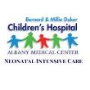
144 Children’s Hospitals

Slide 4
HARM
All Teach
All Learn

Slide 5
130+
1,627
140+
21,445
$402.1
5,000+
118
8
144
125,000+
41
2022
77,000+
10
6,375
69

Slide 6
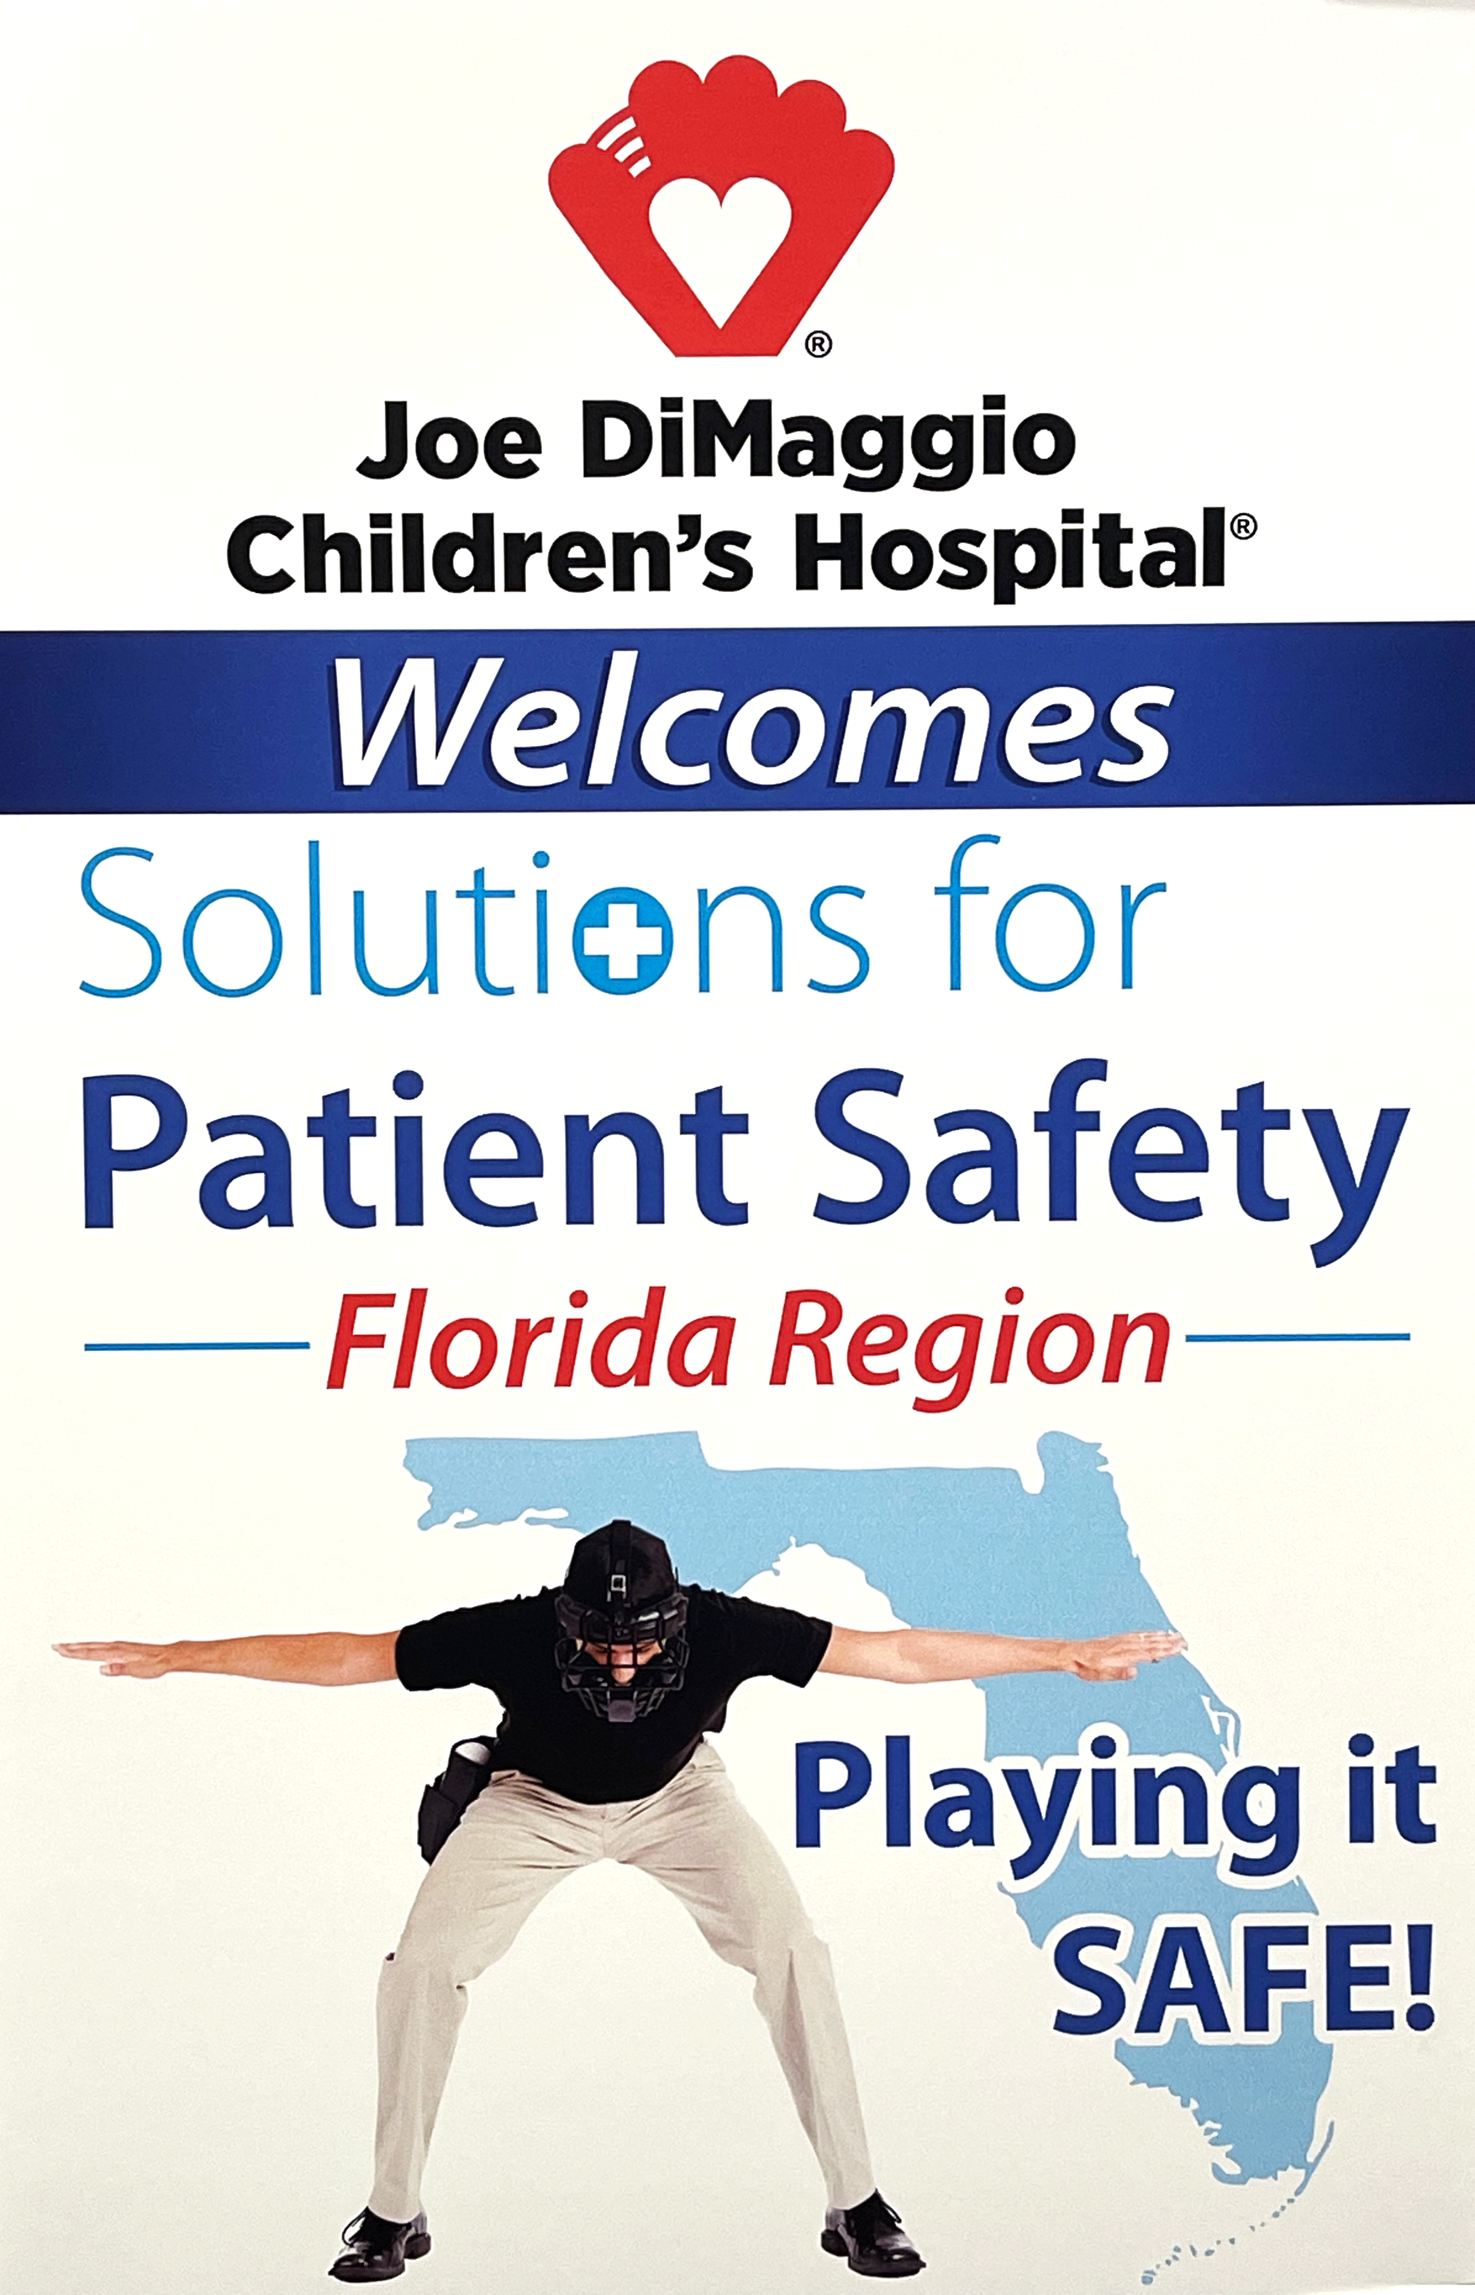
August 29, 2022
104 Attendees
8 Children’s Hospitals

Slide 7
Welcome Florida Region!
Notes:
2 min. to recognize hospitals in attendance

Slide 8
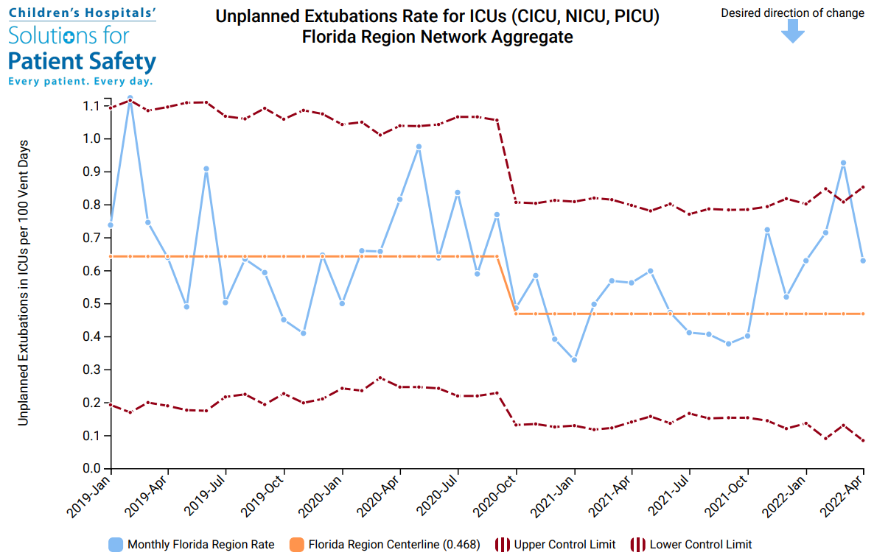
SPS CL 0.590

Slide 9
2022-2024 SPS Network Goals
By June 30, 2023:
By December 31, 2024:
At least 75% of hospitals will achieve:
75% complete Safety Disparities milestones
Hospital Selected Goal
10%
CLABSI
20%
UE
CEO/Top Pediatric Leader joins 2 executive opportunities for Employee Safety Culture
The network will achieve:
30%
SSER
10% DART
20%
PBE-DART
>80% submit stratified DART data
CLICK HERE FOR MORE DETAILS

Slide 10
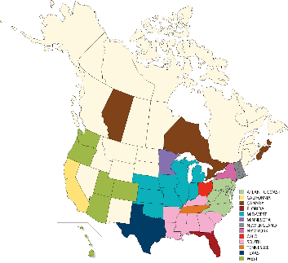
2022-2024 SPS Regional Goal
Each region will achieve ≥75% annual participation in a milestone-based safety improvement challenge
YEAR 1, 2022: Hospital submission of single center PDSA (Plan-Do-Study-Act) abstract
YEAR 2, 2023: Hospital submission of formal progress update on multi-center shared safety improvement testing
YEAR 3, 2024: Hospital contribution to regional improvement “package” to be shared with the network
CLICK HERE FOR MORE DETAILS
Notes:
5 min. for brief reminder of new goal, if teams have questions have them take note of them for the discussion section
Key point: yearly goal will be for at least 75% of the hospitals in the region to complete a specific milestone defined by SPS. Over the 3 years, achievement of the milestones will facilitate regional collaboration around 1-2 improvement ideas that will support progress in key network priority areas. The first step to make this happen is for each hospital to document their local experience with testing an improvement idea and submit an abstract summarizing their findings to SPS later this year. In years 2 and 3, the region will select 1-2 of the ideas that individual hospitals submitted and work together on that same improvement idea. In a few minutes, after we share more regional updates, we’ll discuss this more and answer any questions from attendees.
Embedded link takes you to regional goal summary doc with additional details – can we print off some copies for each region?

Slide 11
Hospital Acquired Conditions
Adverse Drug Events
Catheter Associated UTIs
Central Line Blood Stream Infections
Nephrotoxic Acute Kidney Injury
Peripheral IV Infiltrates
Pressure Injuries
Falls with Injury
Antibiotic Stewardship
Surgical Site Infections
SSI (Colo-rectal)
Unplanned Extubation
Venous Thromboembolism
Ventilatory Associated Events
Employee / Staff Safety

Slide 12
Safety Disparities
Ambulatory Safety
Evolving
Network
Priorities
Patient Behav Events
Staff/Employee Safety

Slide 13
Florida Region
Notes:
2 min. to recognize hospitals in attendance

Slide 14
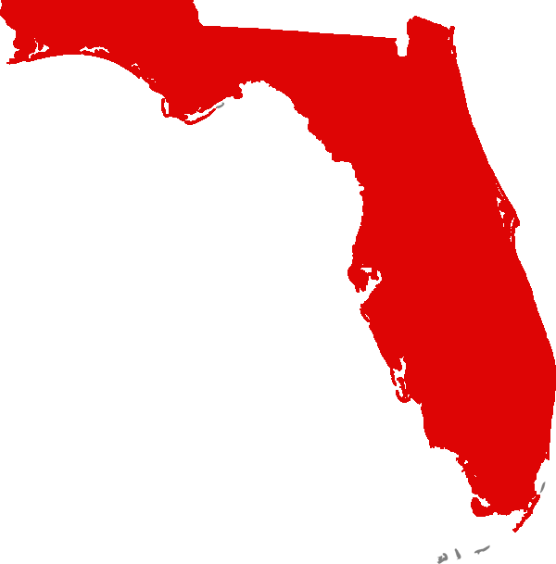
X | X | Advent Health for Children
X | X | Arnold Palmer Hospital for Children
 | X | Children’s Medical Center at Tampa General Hospital
X | X | Golisano Children’s Hospital of Southwest Florida
 | X | Holtz Children’s Hospital at UM/Jackson Memorial
X | X | Joe DiMaggio Children’s Hospital
X |  | Johns Hopkins All Children’s Hospital
X | X | Nemours Children’s Hospital
X |  | Nicklaus Children’s Hospital
 | X | Palm Beach Children’s Hospital at St. Mary’s Medical Center
 | X | UF Health Shands Children’s Hospital
 | X | Salah Foundation Children’s Hospital at Broward Health
X | X | St. Joseph’s Children’s Hospital
 |  | The Studer Family Children’s Hospital at Sacred Heart
X | X | Wolfson Children’s Hospital
(9)
(12)
(7)

Slide 15
Opportunities for
Collaborating
Culture – Engagement - Results

