Slide 1
Understanding the Medicaid Redetermination Process
Tuesday, March 7, 2023

Slide 2
Why We’re Here
The Florida Association of Children’s Hospitals (FACH) is comprised of 13 children’s hospitals in Florida. Member hospitals share a common vision and embrace short- and long-term strategies leading to exemplary health care for Florida’s children.
FACH is hosting today’s training to provide front line staff with accurate information and resources to help families stay in or seamlessly enroll in appropriate health care coverage as the public health emergency comes to an end.
Agenda
Processes, Resources and Coverage Options for Florida’s Families
Julie Reed, Florida Department of Children and Families
Ashley Carr, Florida Healthy Kids Corporation
Melanie Hall, Florida Association of Children’s Hospitals

Slide 3
Florida Department of Children and Families

Slide 4
Medicaid Overview
Subheads Here
Medicaid provides medical coverage to low-income individuals and families.
Medicaid eligibility in Florida is determined either by the Department of Children and Families (DCF) or the Social Security Administration (for Supplemental Security Income (SSI) recipients).
Medicaid services in Florida are administered by the Agency for Health Care Administration (AHCA).

Slide 5
Medicaid Eligibility by DCF
Subheads Here
Individuals potentially eligible for Medicaid include:
Pregnant women
Parents and other caretaker relatives
Children up to age 21
Former foster care children up to age 26
Aged, blind, or disabled not currently receiving SSI
All enrollees must meet eligibility requirements such as identity verification, residency, citizenship, and cooperation with child support.
Some enrollees may be subject to asset limits for eligibility determination.

Slide 6
Income Eligibility Levels
Subheads Here
Eligibility is limited to individuals who do not exceed the income threshold for their category and family size.
Family Size | Parents, Caretakers, Children 19 & 20 | Pregnant Women | Infants <1 | Children 1 through 18
 | ~16% of FPL | 185% of FPL | 200% of FPL | 133% of FPL
1 | $180 | $2,248 | $2,430 | $1,616
2 | $241 | $3,041 | $3,287 | $2,186
3 | $303 | $3,833 | $4,144 | $2,756
4 | $364 | $4,625 | $5,000 | $3,325
Calculations are based on the 2023 Federal Poverty Guidelines.

Slide 7
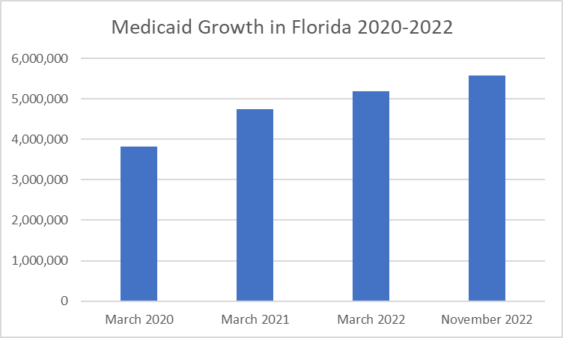
Medicaid Enrollment: By the Numbers
Subheads Here
The Families First Coronavirus Recovery Act has required continuous Medicaid coverage for enrollees since March 2020, for states to continue receiving the increased FMAP rate.
Medicaid recipient data includes both individuals determined eligible by DCF, and SSI recipients approved by the Social Security Administration.
As of April 1, 2023, DCF will return to normal business operations for Medicaid redeterminations.

Slide 8
Federal Consolidated Appropriations Act, 2023
Subheads Here
States must provide continuous coverage for children under 19 for 12 months (currently 12 months up to age 5 and 6 months 5-19) beginning 1/1/2024
Makes permanent the state option for Medicaid postpartum coverage for 12 months
Ends “Continuous Coverage” effective April 1, 2023
To continue receiving the enhanced Medicaid matching rate, states must:
Follow federal Medicaid eligibility requirements
Attempt to ensure updated beneficiary contact information
Make a good faith effort to contact current enrollees by using more than one modality (e.g., hard copy letter and text message)

Slide 9
Core Tenants for Returning to Normal Medicaid Redetermination Processing
Subheads Here
Prioritize exceptional customer service through strong communication and community collaboration
Leverage technology and operational efficiencies
Ensure continuity of coverage for eligible individuals while promoting the availability of alternative health insurance options for those who are no longer eligible

Slide 10
Enhanced Customer Experience/Engagement
Subheads Here
Implementation of system protections to ensure that Medicaid recipients’ coverage will not end until a full redetermination has been completed
Aligning Medicaid redeterminations with Supplemental Nutrition Assistance Program (SNAP) (if applicable) to streamline the customer experience and provide more efficient business operations
Well-coordinated communications plan that incorporates industry and partner feedback
Medicaid recipient address validation campaign
Targeted call center operations, including self-service IVR options, and dedicated staff
Stakeholder meetings:
Community organizations
Associations
Medicaid Managed Care organizations

Slide 11
Communication Strategy
Subheads Here
Direct Communication
Client Call Center
Digital Communication
Email/text messaging
Social Media
Partners
Validating contact information
Partner packets
IVR
How to assist
Postcards
Yellow Stripe Renewal Notices

Slide 12
Technology Enhancements
Auto-Review
Remove filters
Expand sources
Returned Mail
Identify renewals
Text/emails
Chatbots/Videos
“How To” portal
AI assistance
Protections
Prevent closure before renewal
Subheads Here

Slide 13
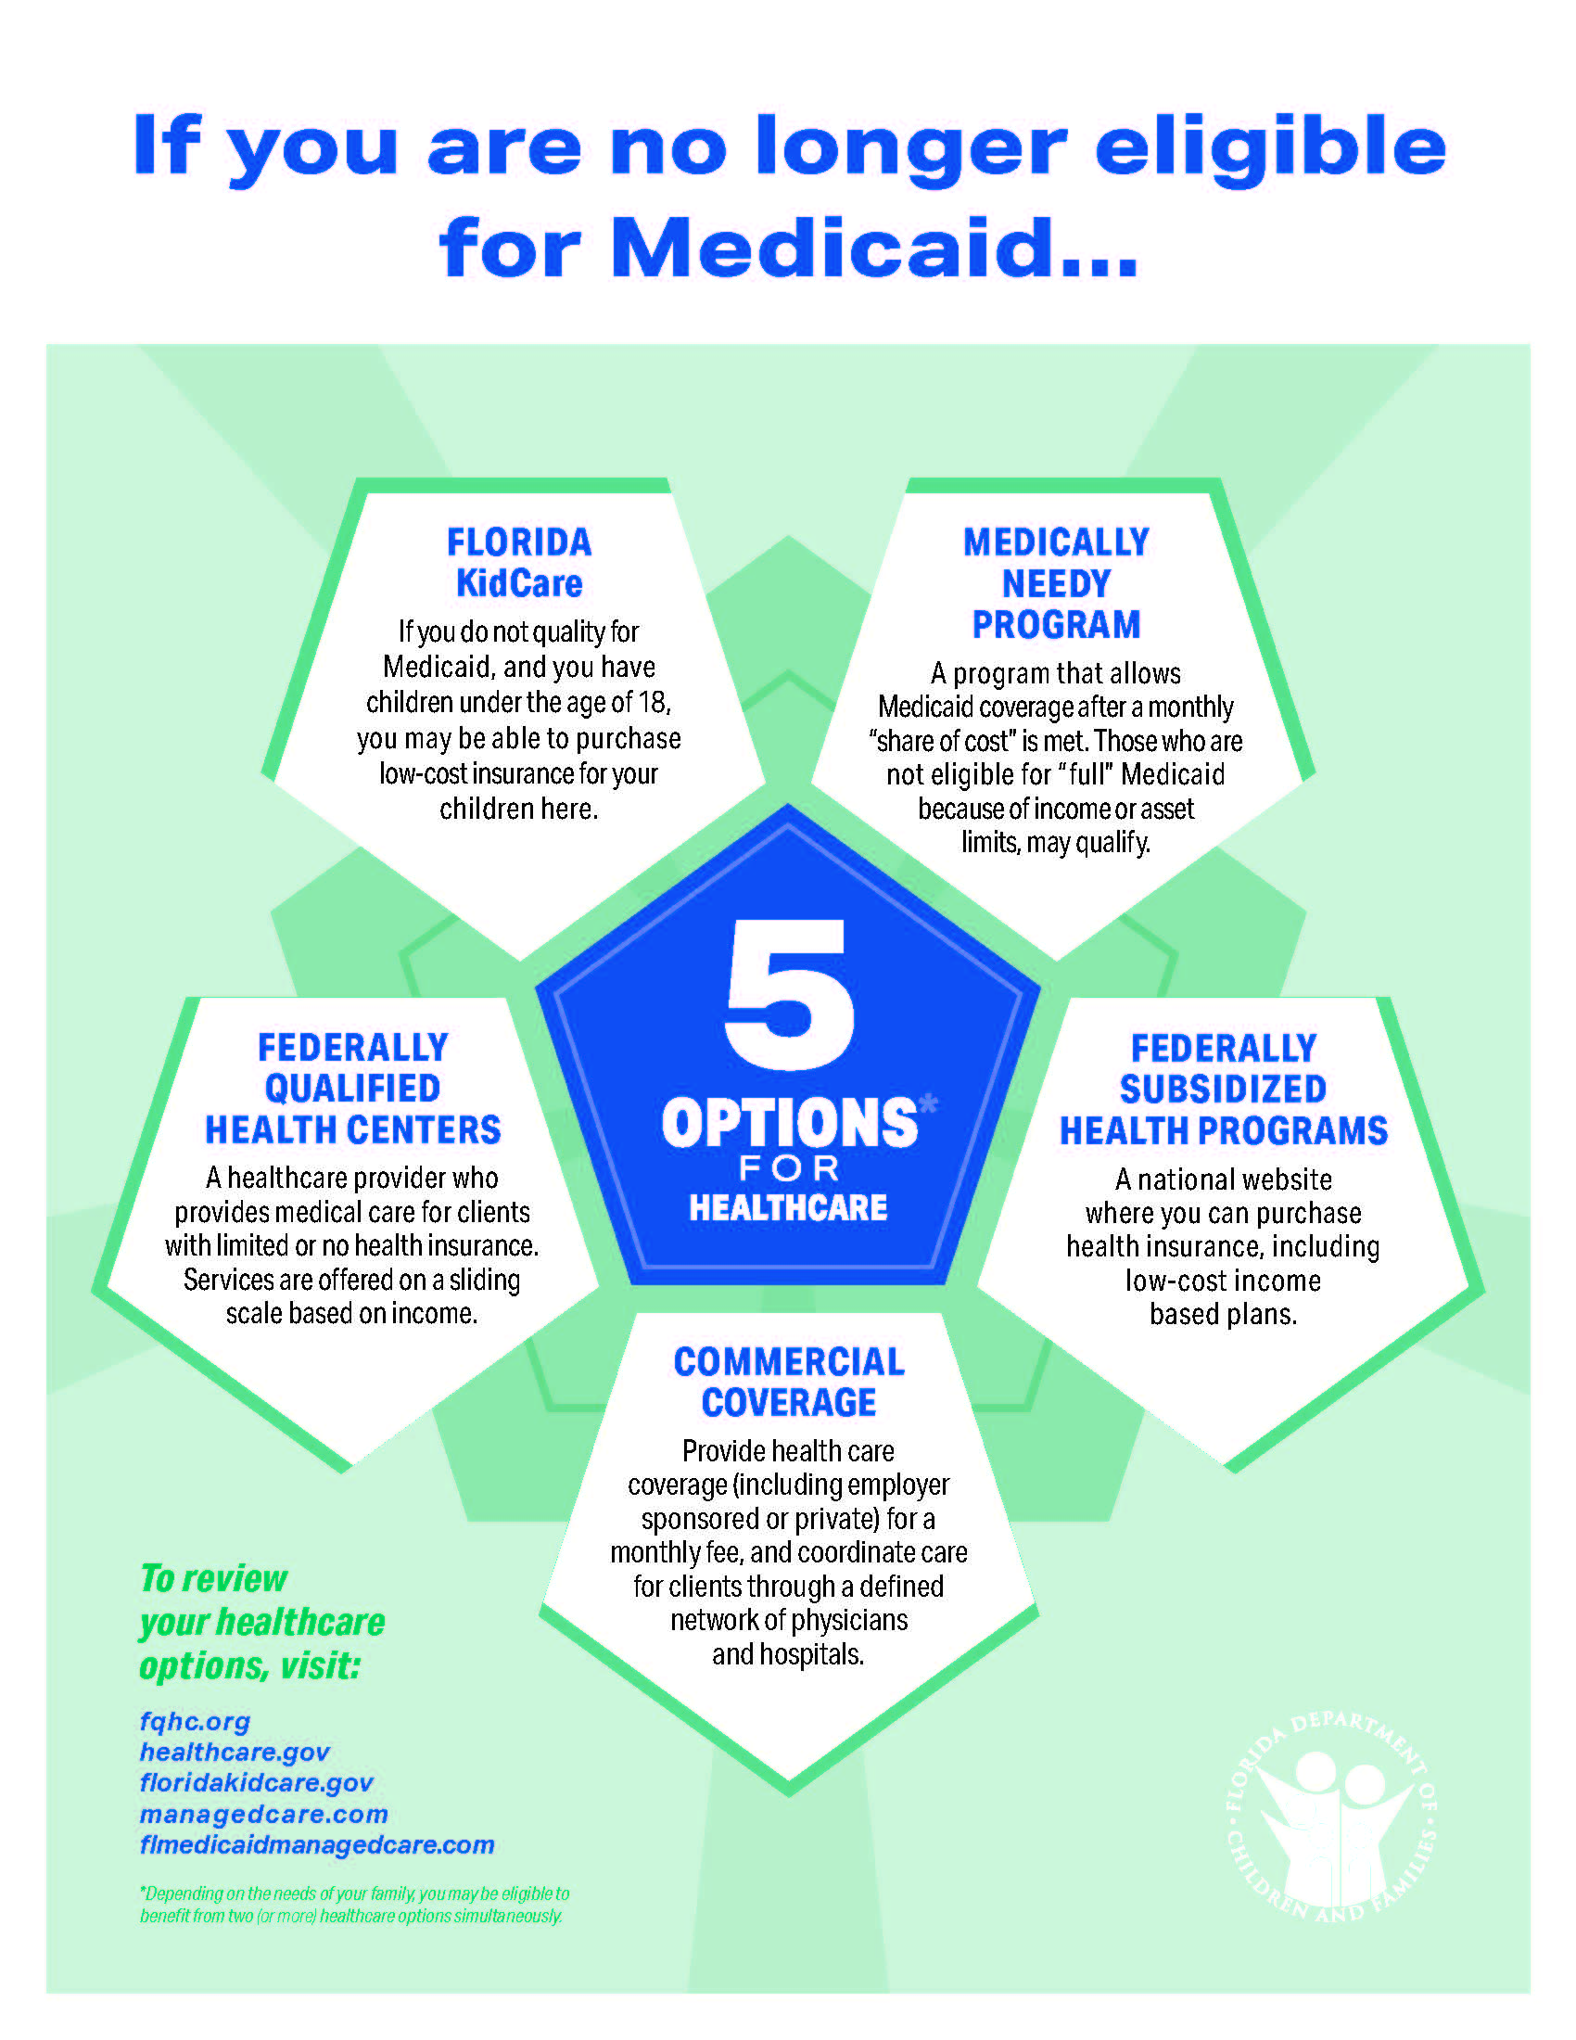
Alternative Coverage
Subheads Here
Current enrollees will receive a notice prior to their renewal date with instructions on how to complete the renewal process
Automatic partner referrals to organizations like Florida Healthy Kids and other subsidized programs
Referral information on website for healthcare navigators

Slide 14
Redetermination Schedule
Subheads Here
The Department will prioritize redeterminations for the following:
Individuals who are no longer eligible based on information on file from their last redetermination date.
We will prioritize recipients who have not used their Medicaid benefit in the last 12 months.
The remaining recipients will be reviewed on their next regularly scheduled renewal date except when we can align the renewal date, when possible, to coincide with:
The date of other members within the household/family unit, or
Their renewal date for SNAP or TANF benefits
Vulnerable populations (e.g., children with complex medical needs) will be last in the review/redetermination schedule.

Slide 15
Florida’s Medicaid Redetermination Operations
March 31
April 1
April 1
Continuous Medicaid enrollment requirement expires
Medicaid renewals resume
New applications and changes processed under standard rules
April 19
Medicaid closure notices sent providing ten-day Adverse Action notice
April 30
May 1 – July
Earliest Medicaid closure effective date
Clients failing to renew benefits have 90 days to reapply with gap coverage
Feb 2023 | Mar 2023 | Apr 2023 | May 2023 | Jun 2023 | Jul 2023 | Aug 2023 | Sep 2023
Oct 2023 | Nov 2023 | Dec 2023 | Jan 2024 | Feb 2024 | Mar 2024 | Apr 2024 | May 2024
FMAP 6.5%
FMAP 5%
FMAP 2.5%
FMAP 1.5%
No enhanced FMAP
Monthly Redeterminations Continue
March 15
February
Notice of Case Expirations for expiring April certifications
Last month to initiate post continuous Medicaid renewals
March 1-3
April
Ex Parte Case Matching initiated for April redeterminations
Last month to complete post continuous Medicaid renewals

Slide 16
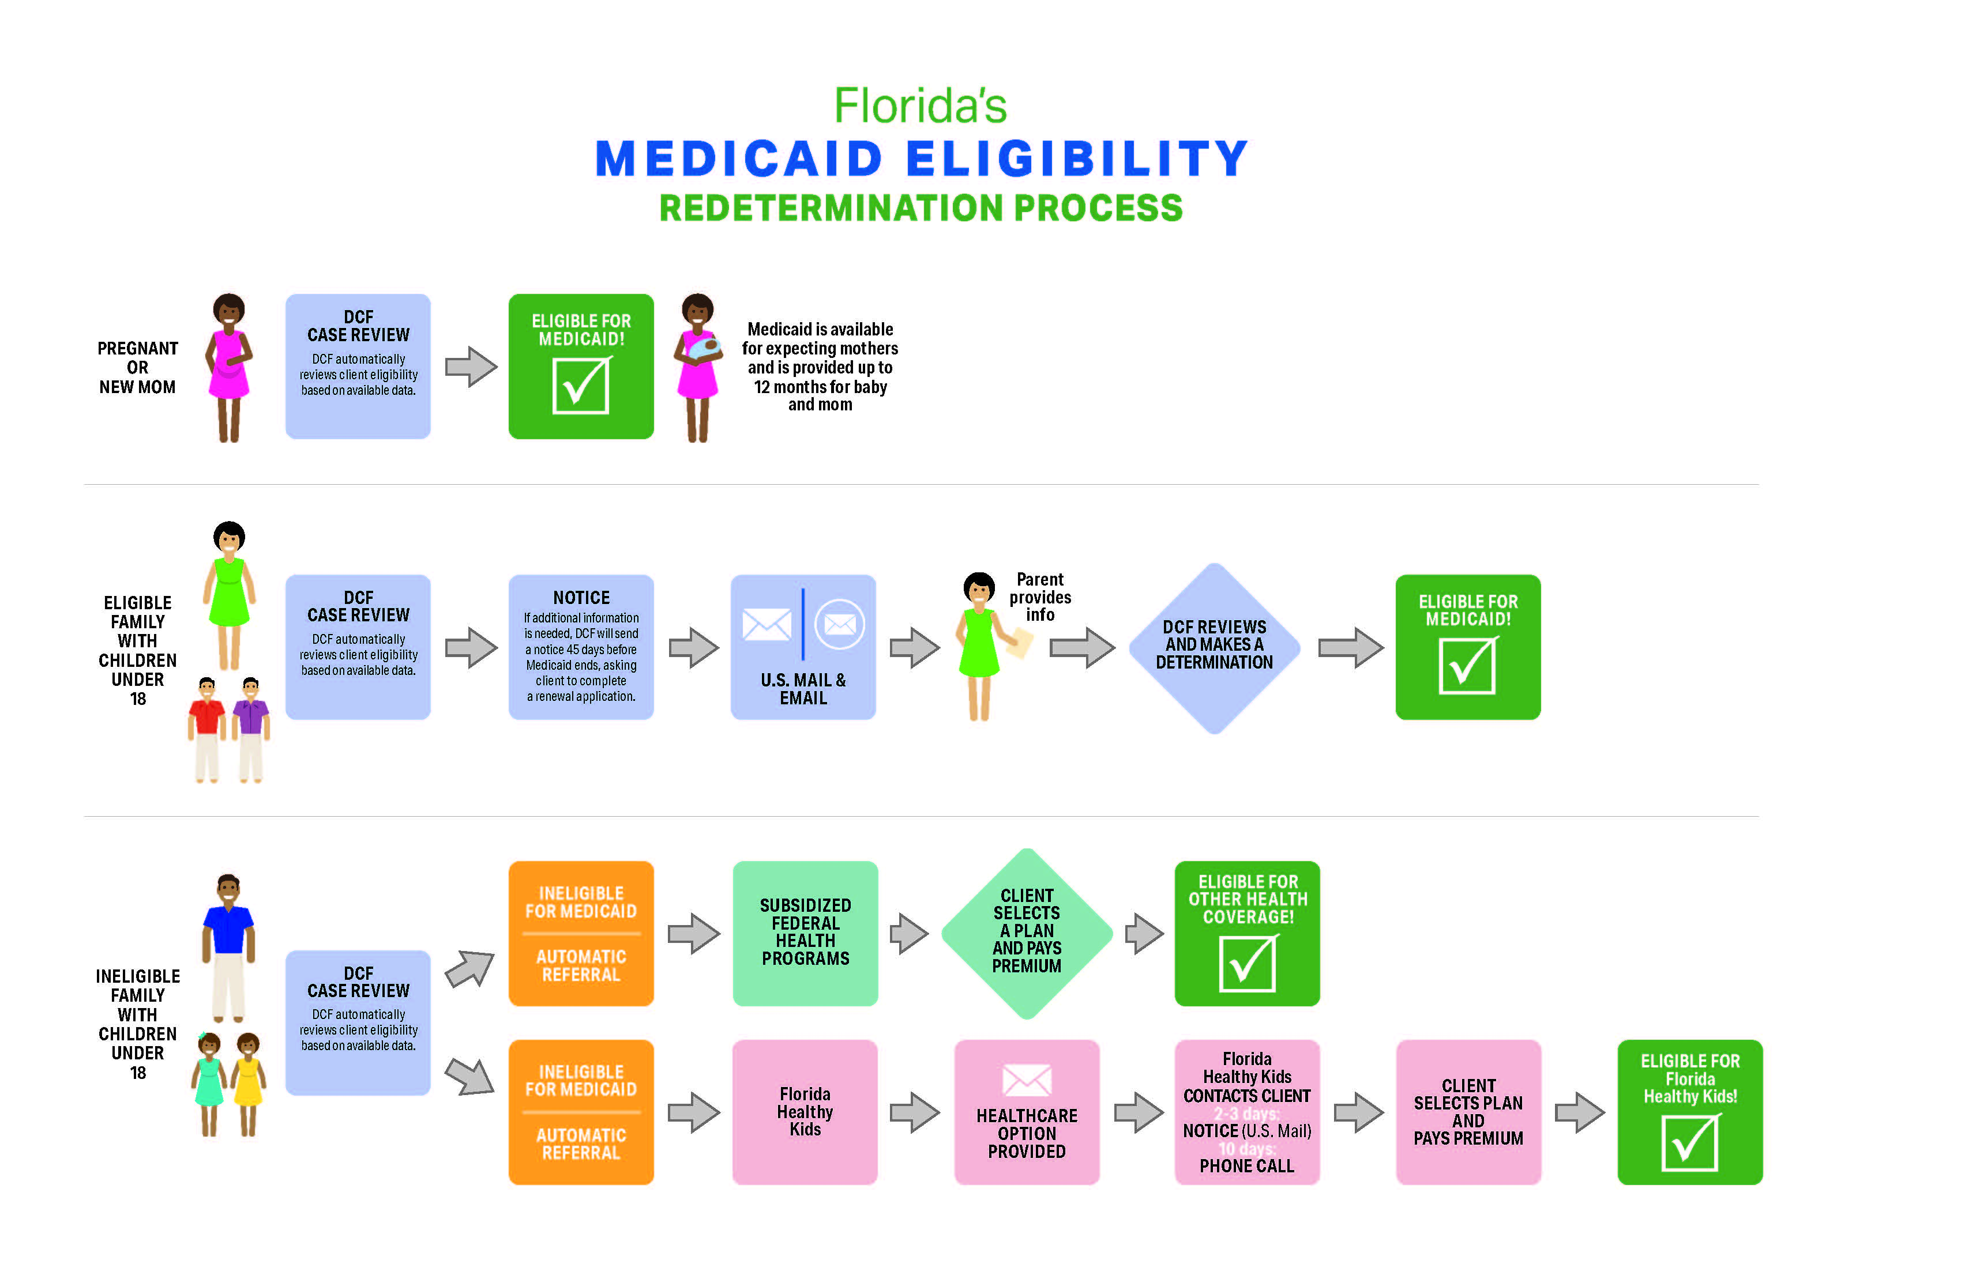

Slide 17
Strategies for Partners
Subheads Here
Ensure Customer Contact Information is up-to-date
Assist with updating address on the DCF customer portal
Stay Informed
Join DCF’s Medicaid email distribution list
Check our web page for up-to-date information – www.myflfamilies.com/Medicaid
Participate in informational calls, meetings, and feedback sessions
Flyers, social media posts, and content creation to be shared with customers seeking assistance
Stay Connected
Constant feedback loop with our state and federal partners to ensure Floridians are informed

Slide 18
How to be a Helpful Partner
PLEASE DO:
Help recipients update their address
Inform recipients to watch out for the “Yellow Stripe” envelope
Urge recipients to respond on time to prevent a break in coverage
Assist clients to access other medical coverage if they are ineligible
Identify systemic concerns with specific and confirmed examples
PLEASE DON’T:
Encourage recipients to apply before their renewal date
Flood call center when redeterminations begin
Recommend appeals/escalation for clients who are ineligible
Confuse implementation of the law with Department policy options

Slide 19
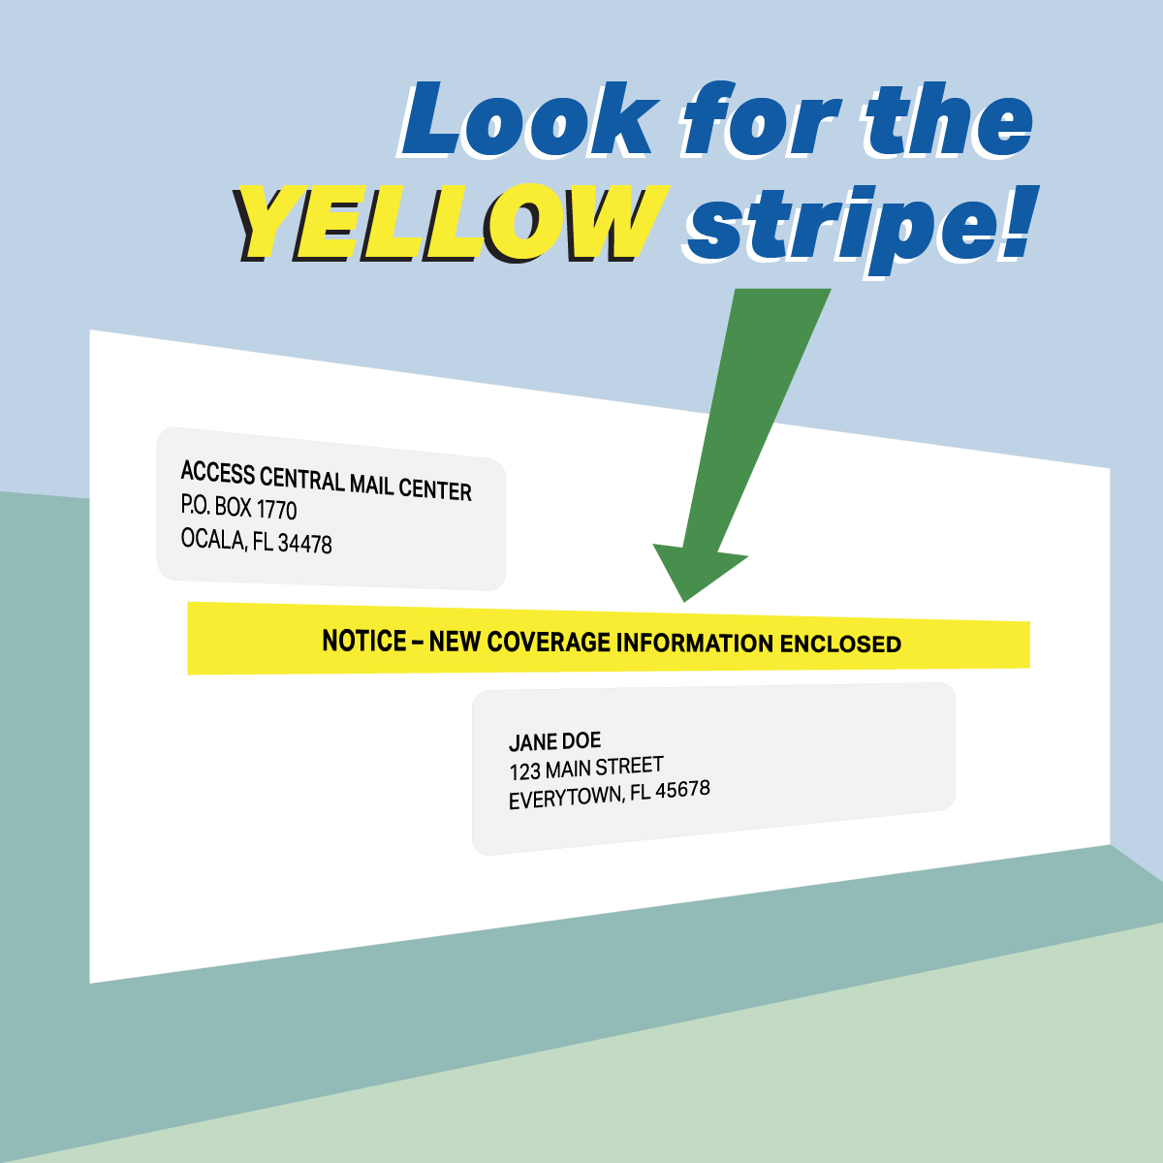
What’s Next
Subheads Here
Federal Guidance
Awaiting final federal guidance from CMS on implementation of Federal Consolidated Appropriations Act, 2023
Medicaid Recipients
Update address and contact information with DCF via MyACCESS Account
Be on the lookout for the yellow stripe envelope
Partners
Sign up for updates through DCF’s distribution list
Partner Packet and Communications

Slide 24
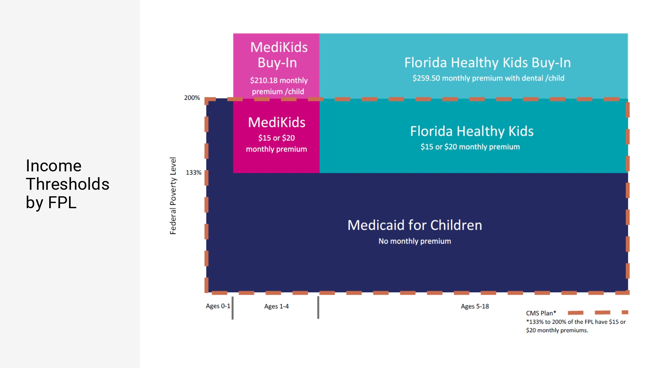

Slide 25
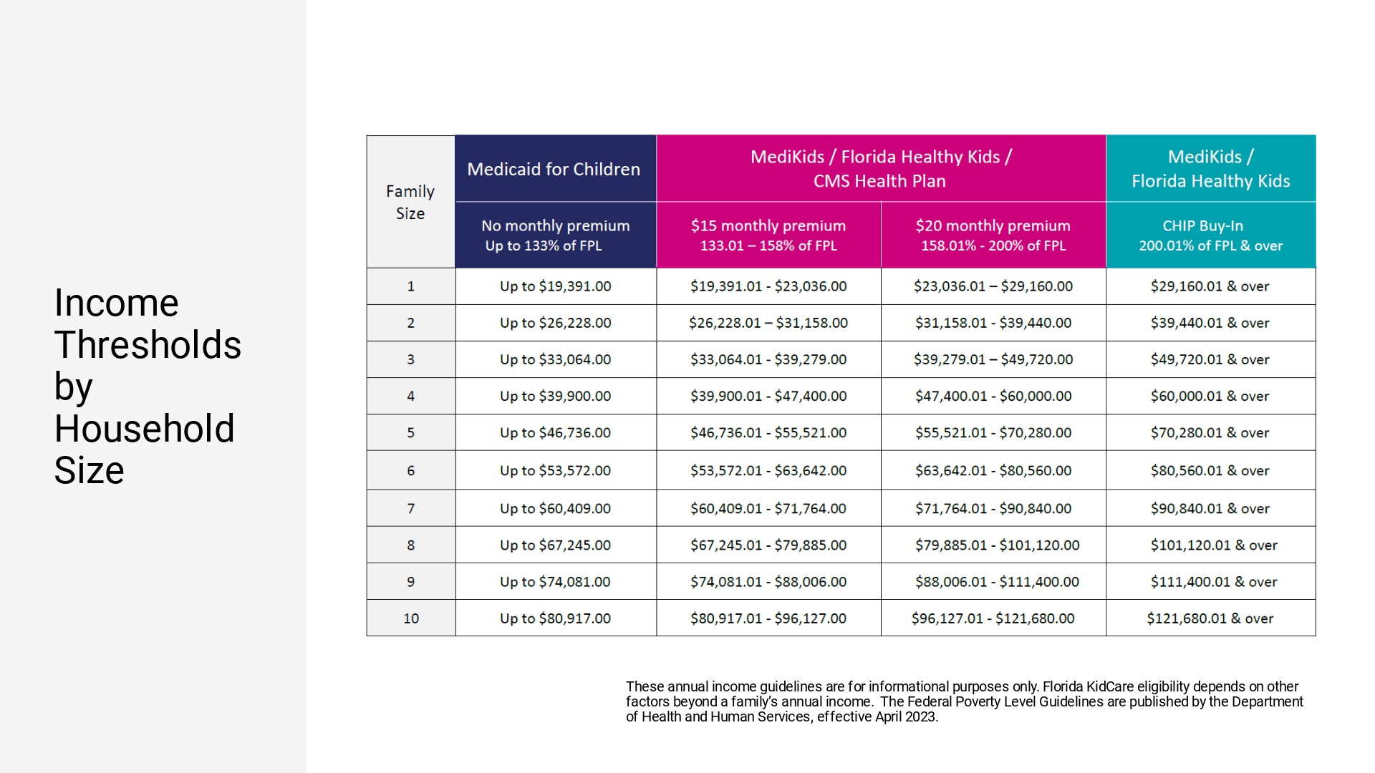

Slide 30
Options for Families through the Health Insurance Marketplace
Special Enrollment Period for Unwinding/Losing Medicaid or CHIP Coverage
Can begin up to 60 days BEFORE the last day of Medicaid or CHIP coverage OR anytime between 3/31/23 and 7/31/24
The Health Insurance Marketplace may be particularly helpful for certain populations:
Infants 0-1 above 200% of the FPL
Children with special health care needs whose providers/therapies/or medications are not covered by the KidCare network
Families with multiple children that qualify for the FHK full pay program
Parents in the Medically Needy Program

Slide 31
Local, objective assistance is available
Leave your name, hospital name and email address in the chat box so we can send you the slides from the presentation, as well as a list of Navigators in each area and statewide.

Slide 32
Questions?
Melanie Hall
melanie.mshconsulting@gmail.com
Medicaid Redeterminations & Florida KidCare Referrals
https://form.jotform.com/230475348172154

